Slide 1




NEXT GEN EMPLOYABILITY PROGRAM
Creating a future-ready workforce
Team Members
College Name
Student Name :Sanjay R Student ID :au951221104041
JP College Of Engineering

Slide 2

CAPSTONE PROJECT SHOWCASE
Project Title
Voting Web Application using Django Framework
Abstract | Problem Statement | Project Overview | Proposed Solution | Technology Used | Modelling & Results | Conclusion

Slide 3
Abstract
Django is a powerful tool in web development, offering everything you need to build complex applications right out of the box. It speeds up development by providing ready-made solutions for tasks like user authentication and managing data in databases. With its Object-Relational Mapping (ORM), working with databases becomes easier and more secure, thanks to built-in protection features. However, Django's strict way of doing things might take some getting used to for beginners, and its all-in-one approach could potentially slow things down in certain situations..
Source :

Slide 4
Problem Statement
Objective: Develop a robust web-based voting application using Django.
Functionality: Users can participate in polls or surveys by casting their votes on various questions or topics.
Features:
View a list of available questions.
Select a question of interest.
Submit votes for one or more choices provided for that question.
Goals:
Create an intuitive user experience.
Ensure security measures are in place to protect the integrity of the voting process.
Build a scalable system capable of handling increased user traffic.
User Experience: Focus on delivering an engaging and user-friendly interface.
Administration: Provide tools for administrators to effectively manage the voting process.
Source :

Slide 5
Project Overview
The project aims to create an advanced web-based voting application using Django, tailored for conducting digital polls, surveys, or elections within organizations, institutions, or communities. The emphasis is on engaging users and promoting transparency. Key features include robust user authentication and registration to ensure secure access. Administrators will have full control over creating and managing polls, with options to customize parameters like titles, descriptions, and question types. Participants will experience an intuitive voting interface capable of handling different question formats, allowing real-time feedback on active polls.
Source :

Slide 6
Proposed Solution
.
1.User Authentication and Registration.
2.Poll Creation and Management.
3.Voting Interface.
4.Real-time Updates and Notifications.
5.Transparent and Auditable Process.
6.Scalability and Performance Optimization.
7.Reporting and Analytics.
8.Compliance and Security.
Source :

Slide 7
Advantages:
Rapid Development: Django's "batteries included" approach and built-in functionalities accelerate development, reducing time-to-market for the voting system.
Robust Security: Django provides robust security features such as protection against common web vulnerabilities like CSRF attacks, XSS attacks, and SQL injection, ensuring the integrity of the voting process.
Scalability: Django's scalability allows the system to handle a large number of users and votes efficiently, making it suitable for elections with varying levels of participation.
Customization: Django's flexible architecture allows for easy customization of features and user interfaces to meet specific requirements of different organizations or communities.
Reliability: Django's stability and reliability ensure minimal downtime and consistent performance, crucial for a critical system like a voting application.
Community Support: Being an open-source framework, Django has a large and active community of developers who contribute to its improvement, providing access to a wealth of resources, libraries, and plugins.
Ease of Maintenance: Django's clean and organized codebase, along with its extensive documentation, makes it easier to maintain and update the voting system over time.
.
Source :

Slide 8
Disadvantages:
Learning Curve: Django's complexity may pose a challenge for developers unfamiliar with the framework, requiring time and effort to learn its conventions and best practices.
Monolithic Nature: Django's monolithic architecture may introduce performance overhead in certain scenarios, especially for large-scale applications with complex requirements.
Overhead: The extensive features and functionalities bundled with Django may lead to unnecessary overhead for simpler voting applications, potentially impacting performance.
Dependency Management: Managing dependencies and updates for Django and its associated packages can be challenging, especially when dealing with compatibility issues between versions.
Scalability Constraints: While Django offers scalability, achieving high scalability may require additional optimizations and architectural considerations, which can be complex to implement.
Vendor Lock-In: Developing a voting system using Django may lead to vendor lock-in, limiting flexibility and making it difficult to migrate to alternative frameworks or technologies in the future.
Limited Frontend Flexibility: Django's focus on backend development may result in limited flexibility and customization options for frontend interfaces, requiring additional effort to implement complex frontend features.
Source :

Slide 9
Technology Used
Front-end
Back-end
HTML
PYTHON
CSS
DJANGO
JAVASCRIPT
SQL
BOOTSTRAP
Source :

Slide 10
Modelling & Results
In developing a voting app with Django, great care is given to both structuring the data and presenting results effectively. Using Django's model system, the app's data architecture, often involving models like Question and Choice, is meticulously designed to represent polls and choices. Once users vote, delivering results becomes crucial. Django's templating system dynamically generates HTML templates, showcasing voting outcomes in an intuitive and visually appealing way. Additionally, the app may employ charting libraries or custom visualization methods to illustrate vote distribution, providing users with valuable insights into the voting process.
Source :

Slide 11
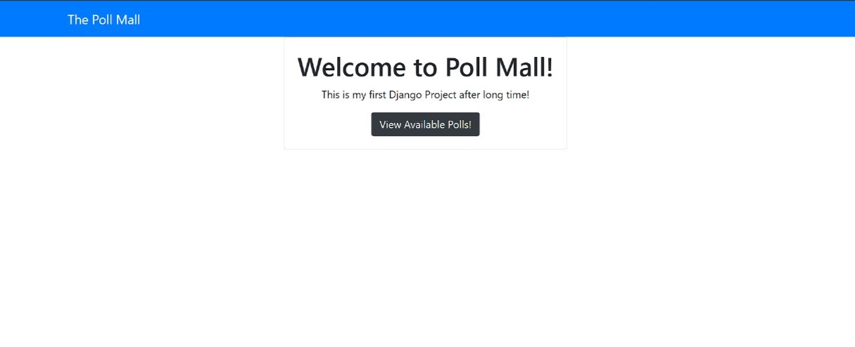
Homepage

Slide 12
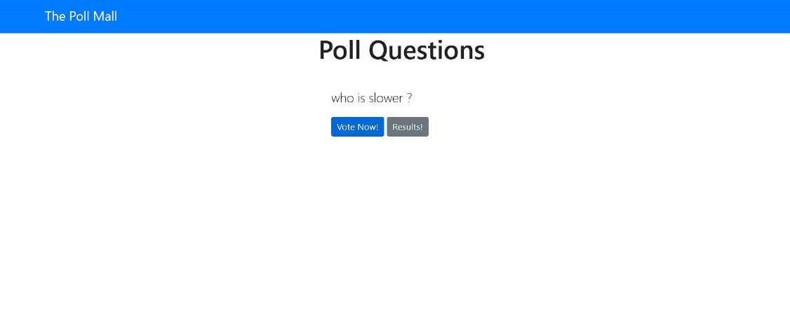
Polling page

Slide 13
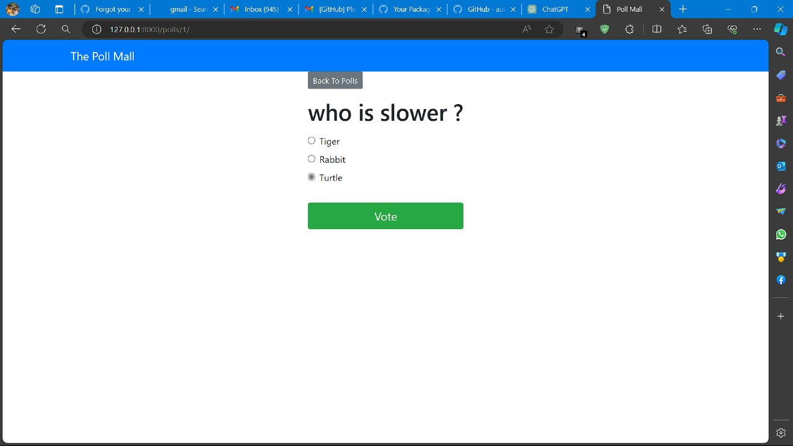
Voting page

Slide 14
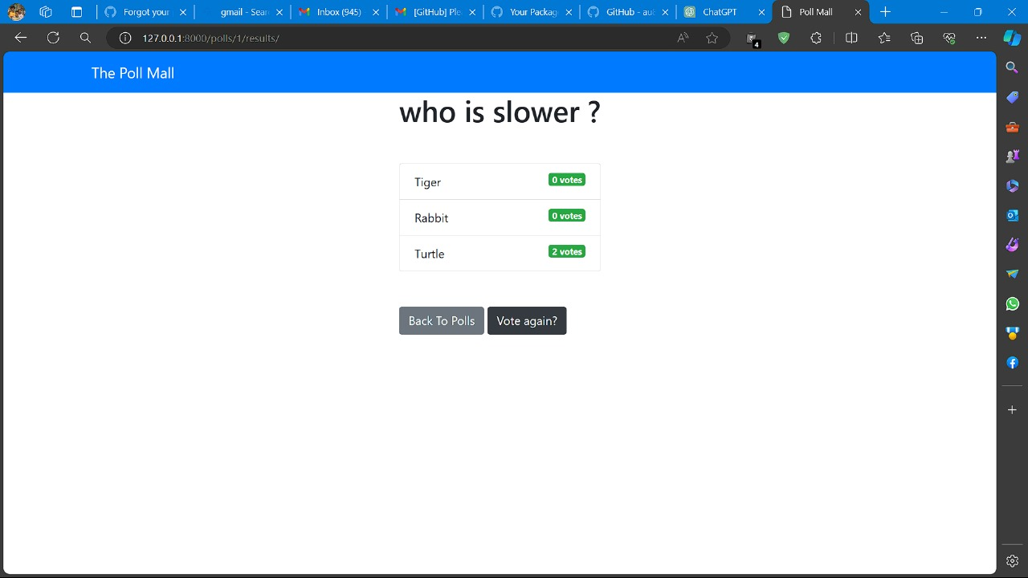
Admin page

Slide 15
Future Enhancements:
To elevate the voting app, numerous avenues for improvement arise to enhance functionality and user engagement. Integrating advanced analytics tools allows administrators to extract deeper insights into voting behaviors, demographic trends, and predictive modeling for future outcomes. Additionally, incorporating social media integration can boost engagement by enabling users to effortlessly share their voting activities and poll results across popular platforms, expanding reach and community involvement. Real-time collaboration features offer further enhancement, empowering teams or committees to collectively create and refine polls, augmenting decision-making processes.

Slide 16
Conclusion
In conclusion, the development of the voting application using Django has laid a strong groundwork for fostering democratic participation and decision-making. With careful attention to data modeling and result presentation, the app offers a transparent and user-friendly experience. Yet, the journey continues. Embracing future enhancements like advanced analytics, social media integration, real-time collaboration, and mobile accessibility will ensure the application evolves to meet changing user and administrative needs. Ultimately, the voting app serves as a testament to technology's role in promoting civic engagement, empowering individuals, and supporting democratic principles..
Source :

Slide 17
Thank You!
Notes:
Thank You !!

